Slide 1
MGMT 58600: Python Programming
Lecture 3
Dr. Shoaib Khan

Slide 2
Repetition
A repetition statement is used to repeat a group(block) of programming instructions.
In Python, we generally have two loops/repetitive statements:
for loop (definite iteration)
while loop (indefinite iteration)

Slide 3
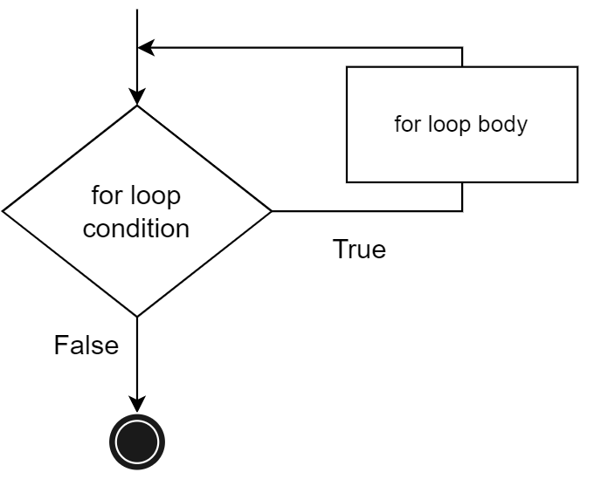
for Loop
A for loop is used to iterate over a sequence (a list, tuple, dictionary, or a set). We can execute a set of statements once for each item in the sequence.
for <var> in <iterable>:
<statement(s)>
print("1st example")
lst = [1, 2, 3]
for i in range(len(lst)):
print(lst[i], end = " \n")
print("2nd example")
for j in range(0,5):
print(j, end = " \n")

Slide 4
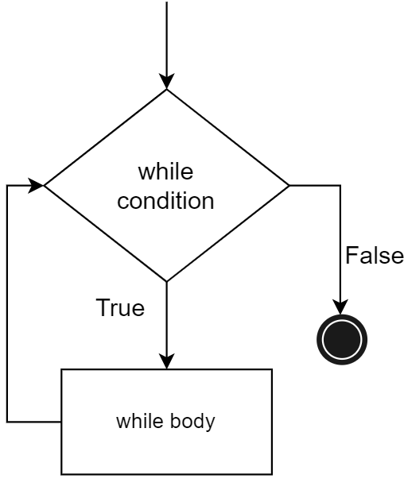
while Loop
while loops are used to execute a block of statements repeatedly until a given condition is satisfied.
The expression is checked in each iteration and, if it is still true, the body is executed again…
..until the expression becomes false.
while <expr>:
<statement(s)>
m = 5
i = 0
while i < m:
print(i, end = " ")
i = i + 1
print("End")

Slide 5
Functions
A function is a packaged block of statements that performs a specific task
A function has a name and only runs when it is called.
You can pass data, known as parameters (or arguments), into a function.
A function can return data (output or return value) as a result.
There are two types of function in Python programming:
Standard library functions - These are built-in functions in Python that are available to use e.g. print(), len(), str(), int() etc.
User-defined functions - We can create our own functions based on our requirements.

Slide 6
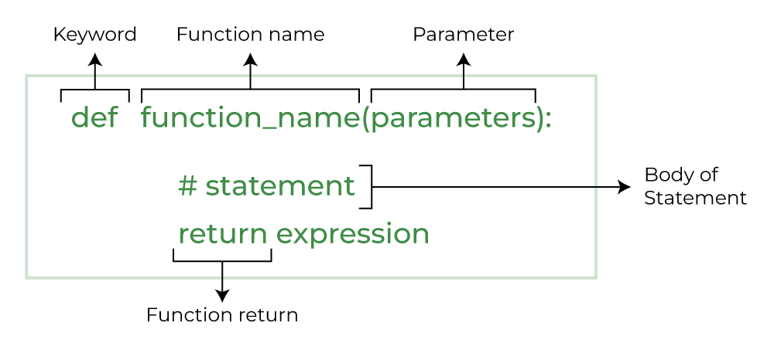
Python Function Declaration
The syntax to declare a function is:

Slide 7
Some Examples
# A simple Python function
def fun():
print("Welcome to MGMT 586")
# Driver code to call a function
fun()
def add(num1, num2):
"""Add two numbers"""
num3 = num1 + num2
return num3
# Driver code
num1, num2 = 5, 15
ans = add(num1, num2)
print(f"The addition of {num1} and {num2} results {ans}.")

Slide 8
Why Use Functions?
Dividing a complex problem into smaller chunks makes our program easy to understand and implement
Reduces duplicate code within a program
Enables reuse of code across multiple programs
Divides a large programming task among various programmers or various stages of a project
Hides implementation details from users of the function
Improves readability of code by replacing a block of code with a function call where a descriptive function name serves to describe the block of code
Makes software easier to test, debug and maintain

Slide 9
Call Stack
A Stack is a Last-In-First-Out (LIFO) data structure
The call stack (an OS level stack) is how a program remembers where to return the execution after each function call.
The call stack isn’t stored in a variable in your program; rather, Python handles it behind the scenes.
When your program calls a function, Python creates a frame object on the top of the call stack.
Frame objects store the line number of the original function call so that Python can remember where to return.
If another function call is made, Python puts another frame object on the call stack above the current one.

Slide 10
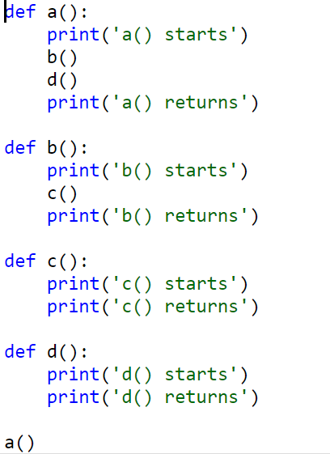
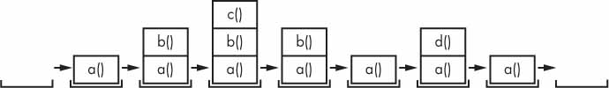
Call Stack Example

Slide 11
Scope of Variables
Parameters and variables that are assigned inside a function are said to exist in that function’s local scope.
Variables that are assigned outside all functions are said to exist in the global scope.
A variable that exists in a local scope is called a local variable
A variable that exists in the global scope is called a global variable.

Slide 12
Scoping Rules
Local variables cannot be used in the global scope
def spam(): eggs = 31337 spam() print(eggs)
Local scopes cannot use variables in other local scopes
def spam(): eggs = 99 bacon() print(eggs) def bacon(): ham = 101 eggs = 0 spam()

Slide 13
Scoping Rules
Global variables can be read from a local scope
def spam(): print(eggs)
eggs = 42 spam() print(eggs)
Local and global variables with the same name
def spam(): eggs = 'spam local' print(eggs) # prints 'spam local' def bacon(): eggs = 'bacon local' print(eggs) # prints 'bacon local' spam() print(eggs) # prints 'bacon local’ eggs = 'global' bacon() print(eggs) # prints 'global'

Slide 14
The global Statement
If you need to modify a global variable from within a function, use the global statement
def spam(): global eggs eggs = 'spam' eggs = 'global' spam() print(eggs)

Slide 15
Four Rules
There are four rules to tell whether a variable is in a local scope or global scope:
If a variable is being used in the global scope (that is, outside of all functions), then it is always a global variable.
If there is a global statement for that variable in a function, it is a global variable.
Otherwise, if the variable is used in an assignment statement in the function, it is a local variable.
But if the variable is not used in an assignment statement, it is a global variable.

